Slide 1
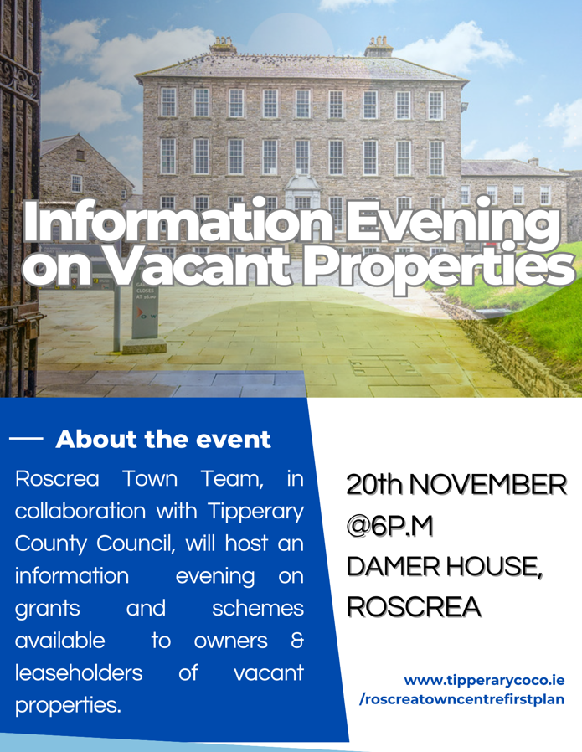


November 2023

Slide 2

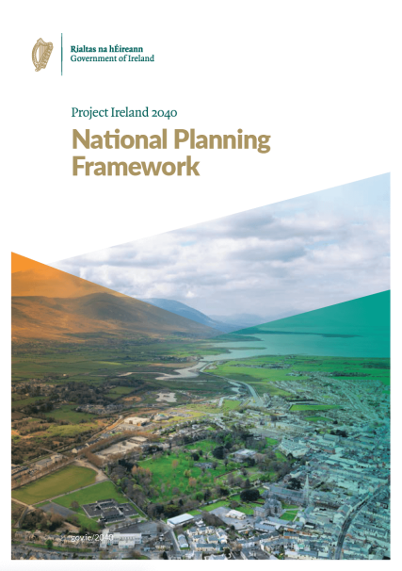
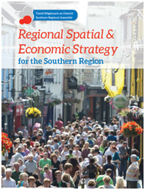
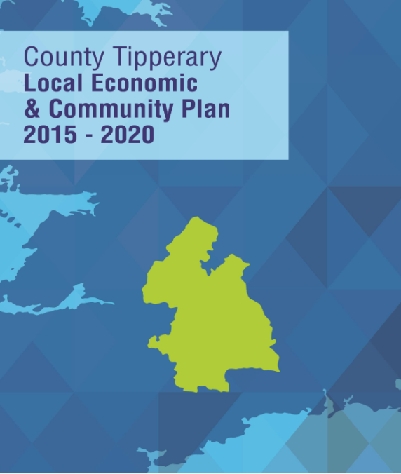
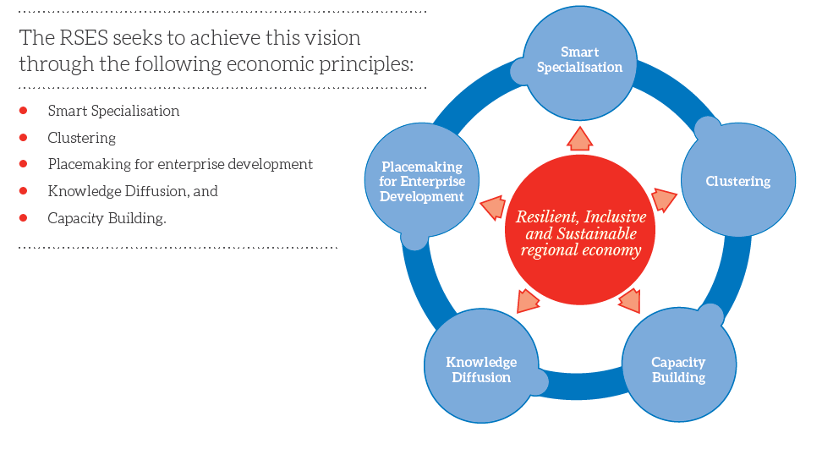
Policy: What has changed?
Objective of the RSES .....to provide a long-term strategic planning and economic framework for the development of the region for which the strategies are prepared which shall be consistent with the National Spatial Strategy and the economic policies or objectives of the Government.
Notes:
Not only was the RSES to be an land use framework, but it was also to be economic framework. Land use considerations.
The NPF recognises the importance of our built and cultural heritage in our quality of life and our identity. Built and cultural heritage includes sites and monuments, landscapes, buildings and folklore and sporting traditions etc. These are important to our character and communities, and strengthen social and economic opportunities including tourism, recreation and town centre regeneration and quality.
Policies and objectives are outlined in the Plan to protect and support historic structures, support the active reuse of old buildings, support the recording and monitoring of historic features and build on the economic opportunities of heritage-led regeneration etc. This framework will also support a scheme of grant aid and supports for protected structures and structures in Architectural Conservation Areas.

Slide 3
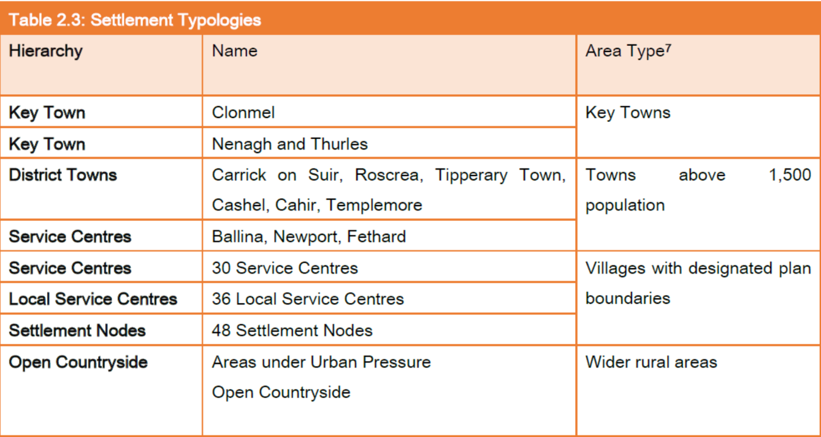




Our Settlement Strategy & Economic Strategy
Jobs
Services
People
“The creation of attractive places to live and work…can provide a completive edge to Irish Towns and cities when it comes to attracting FDI”

Slide 4
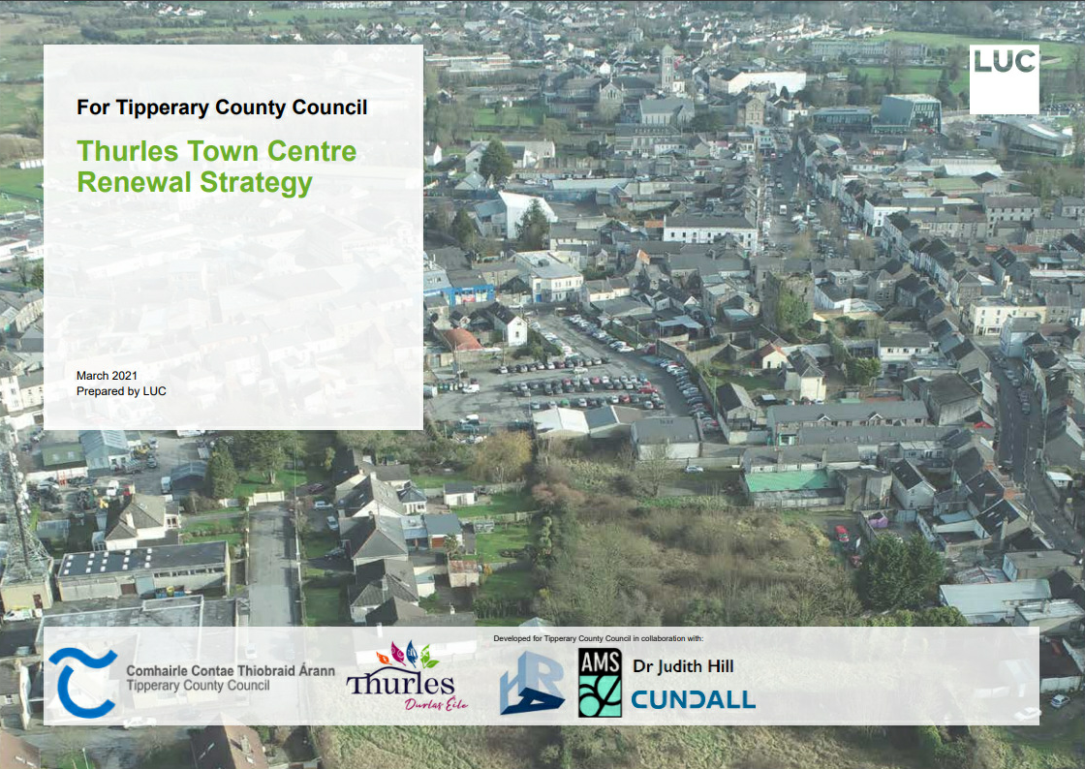
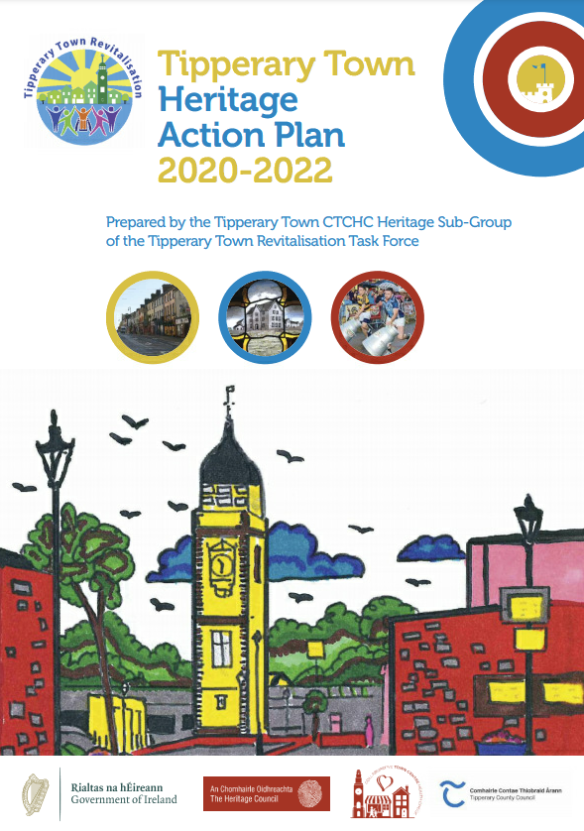
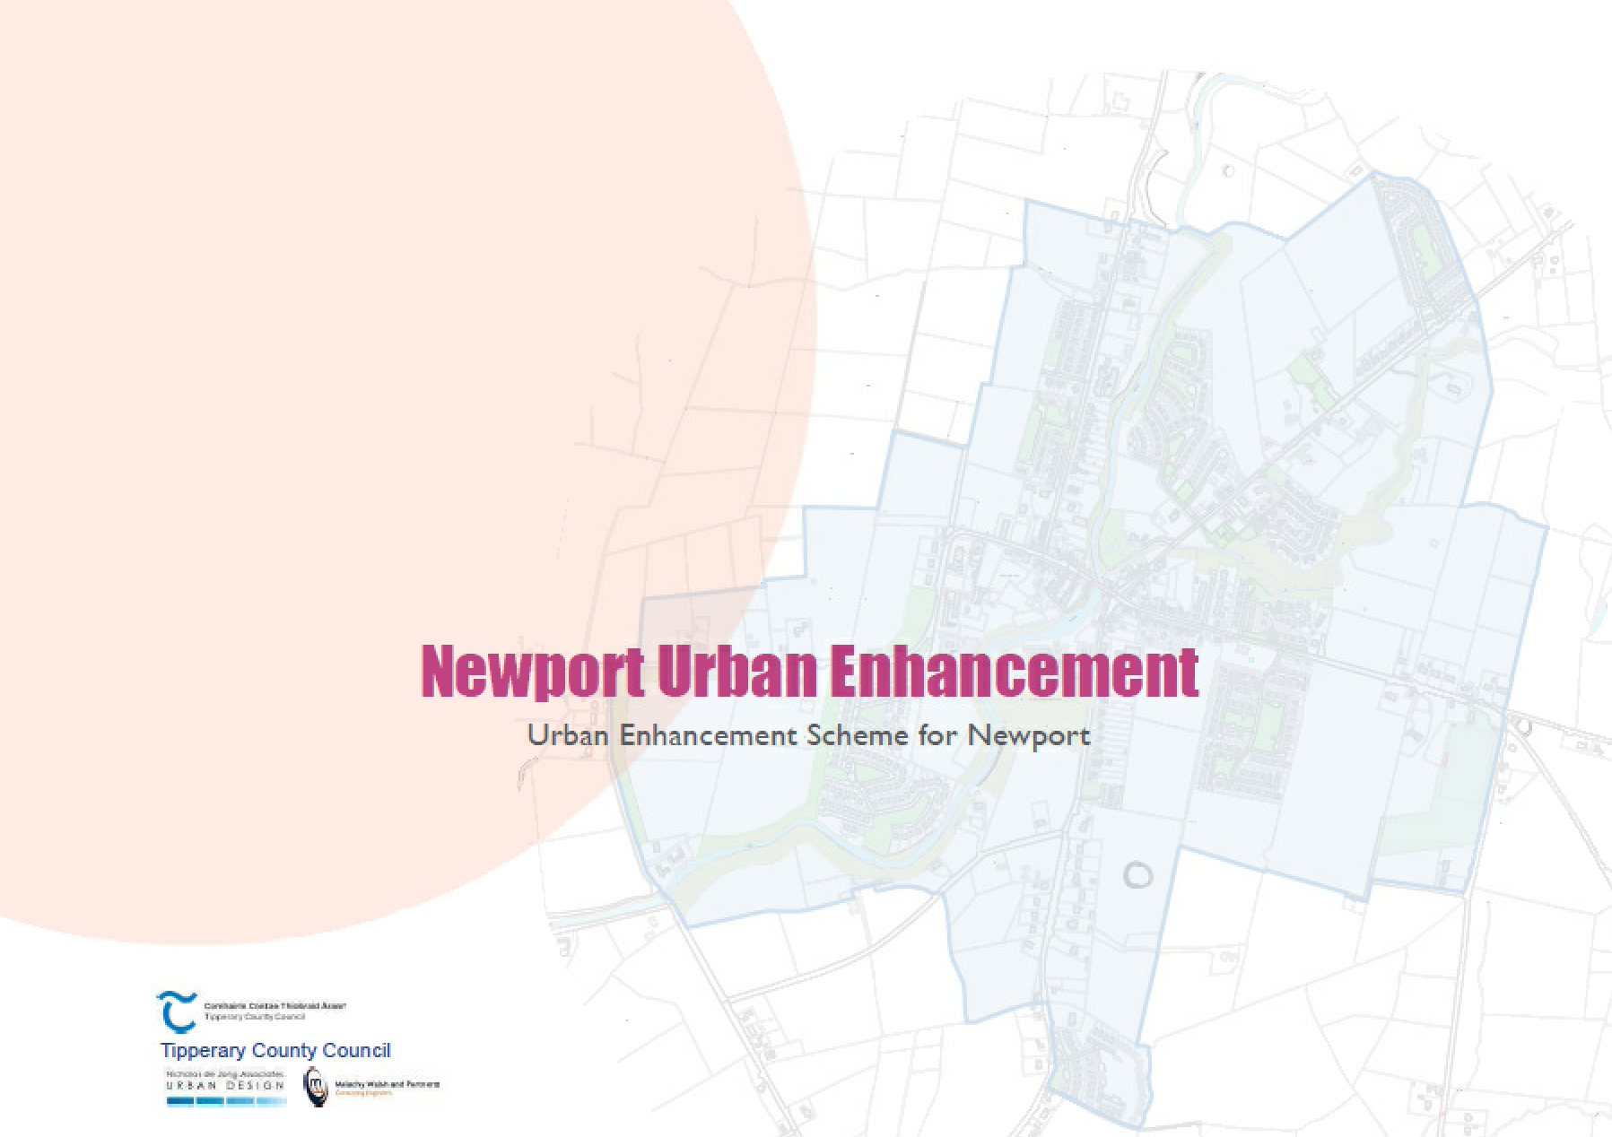

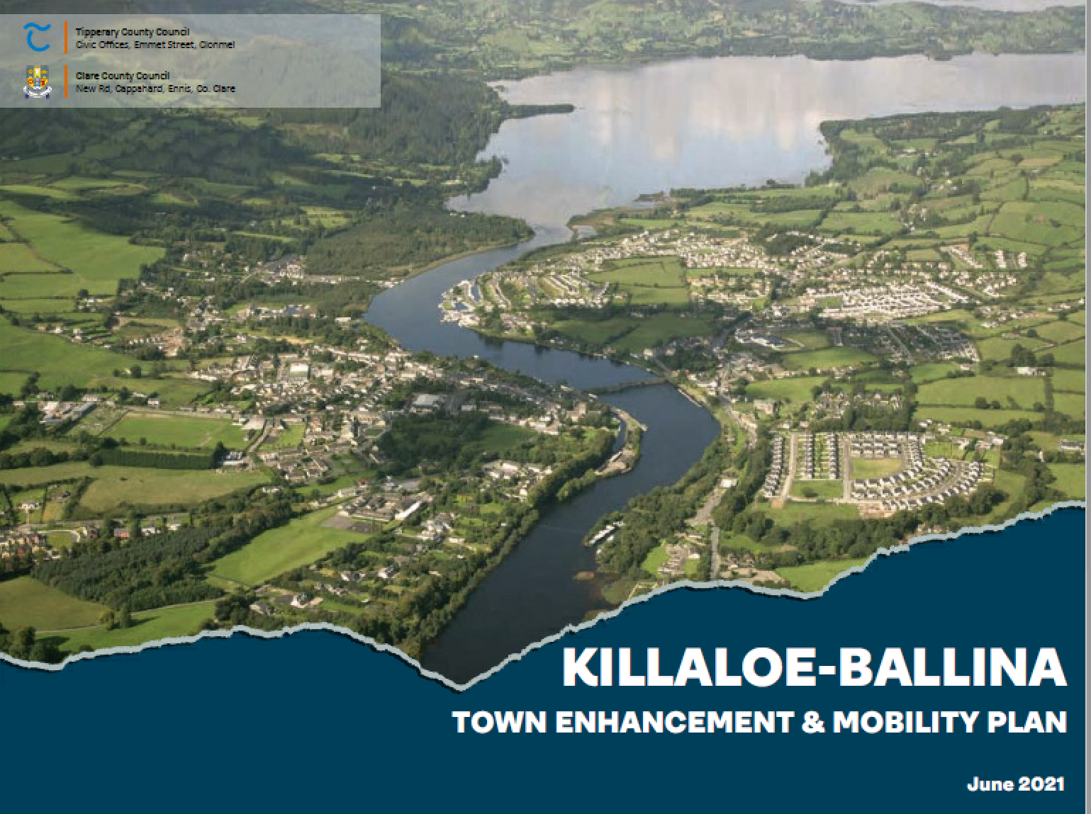
Policy Framework
Tipperary CDP sets out framework
TDPs and LAPs
Settlement Hierarchy
Notes:
The planning framework within which the North and South Tipperary County Development Plans were prepared is significantly different from the scenario for the new planning framework, whereby there will be a single County Development Plan for Tipperary, supported by Local Area Plans for each of the large settlements (9 in total). In the current planning framework the County Development Plans focus mainly on the rural economy, whilst the Town Development Plans deal with urban economic development.
The Draft CDP sets out a refocus of planning policies from controlling retail and commercial developments through the Development Management process, to providing high quality living and working environments in our town centres. This is achieved through creating high quality physical environments through investments and delivery of projects which in turn aim to stimulate economic revitalisation and regeneration.

Slide 5
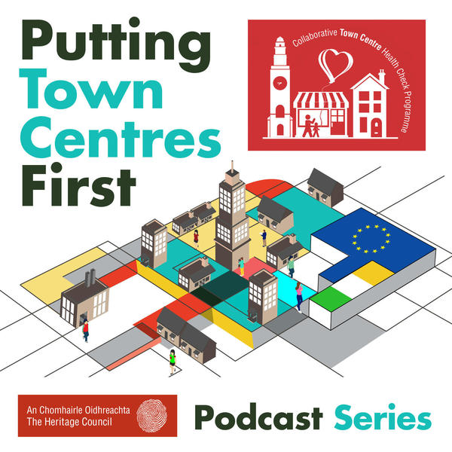
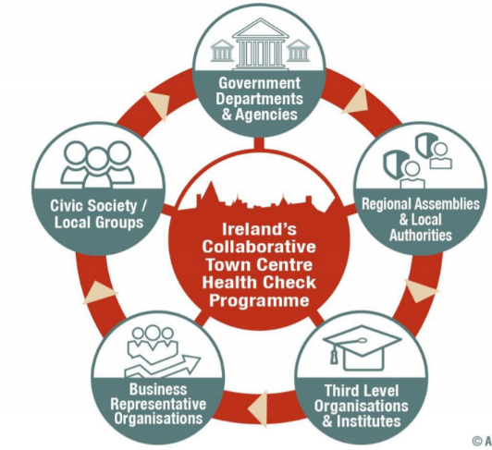
Our Town Regeneration Strategy
Settlement Strategy and Compact Development – ‘Town-Centre First’
Local Town Regeneration Teams
Notes:
Town Centres historically have been the focal point of commercial activity in rural towns supporting the town and a wider hinterland. The role of the town centre over past decades has changed substantially with the emergence of on-line retailing and the significant decline of residential function.
This Plan, supports a ‘Town Centre First’ approach through utilising existing buildings and unused lands for new development, addressing vibrancy and opportunities for investment and regeneration while promoting residential occupancy
The Town Centre first approach recognises town centres’ role at the core of community and economic life. The approach prioritises a Town Centres First collaborative and strategic approach to the regeneration of our villages and towns, using the Collaborative Town Centre Health Check (CTCHC) framework to gather data and lead actions.
This approach has already been embraced in towns in the County, for example, in Tipperary Town, where the Tipperary Town Task Force has applied the Heritage Council led Collaborative Town Centre Health Check (CTCHC) framework to gather data and lead actions. The CTCHC supports better town management by closely working with the business community, detailed surveys and consideration of local matters such as vacancy etc. The Council supports the CTCHC approach as a part of an integrated approach to town centre management, revitalisation and regeneration The Heritage Council, RGDATA and the Retail Consortium, have developed a trans-disciplinary National Collaborative Town Centre Health Check Programme (CTCHC).
The Council will continue to dedicate resources and support for these important programmes. As part of its regeneration programme

Slide 6
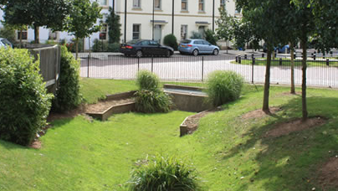
Our Town Regeneration Strategy
NPF “10-Minute Town” concept
Greening Our Urban Areas
Vacant Property Strategy
Notes:
The Plan also supports the NPF “10-Minute Town” concept in seeking to have all community facilities and services accessible within a 10-minute walk or cycle from homes, or accessible by public transport services, and in turn reducing the need to travel by car and carbon emissions. The Southern Regional Assembly have produced a framework and methodology that will support local transport planning for our Key Towns, and this will be further developed through a framework for active travel and sustainable transport in our towns and villages, see Chapter 12 Sustainable Transport
Greening of our streets, buildings and other public spaces does more than change the look of these places. Roofs and walls covered in plants, street trees and small pocket parks in between buildings make our towns a better place to live, work and invest. These green features act as part of our green infrastructure network to help clean our air, reduce the risk of flooding.
A diversity of uses makes an important contribution to the function of town centres, and as such a mix of uses will be accommodated to facilitate the provision of a range of services, and to enhance the vibrancy of towns
The Plan supports investment in natural and indigenous planting and landscaping in urban areas, in accordance with the approach set out in the All Ireland Pollinator Plan. New developments shall include urban greening as a fundamental element of the site and building design incorporating measures such as high-quality bio-diverse landscaping (including tree planting), nature-based solutions to SUDS and providing attractive routes and facilities for the pedestrian and cyclist
The ability of existing building stock and brown-field sites, within existing-built up footprints of towns to accommodate new homes, is a focus of the Council, noting the NPF objective that at least 30% of new population growth should occur within urban areas. In line with Project Ireland 2040, the Council will actively undertake collaborative regeneration and land activation measures, to realise the housing potential of existing vacant and underused building stock. Land activation measures are addressed in detail in Chapter 7 Town Centres and Placemaking. The reuse of existing vacant and derelict buildings as potential homes is supported.

Slide 7
Planning Policies – County Development Plan
4.8 Living over the Shop Proposals for the residential development of upper floors in town centre commercial, office and retail properties will be encouraged where they are deemed to contribute positively to the renewal of areas and where any proposed modifications will not have a negative impact on visual amenities or the existing streetscape. Subject to the design quality of the development, there may be circumstances where private open space and car-parking standards can be relaxed. In such cases a high level of residential amenity shall be provided ensuring natural light in living rooms and bedrooms, and minimum standards are met in relation to overall floor areas and storage space requirements as set down in the Sustainable Urban Housing: Design Standards for New Apartments (DHPLG, 2018), and guidance set out in Bringing Back Homes: Manual for the reuse of existing buildings, (DHPLG, 2018). Residential development may also be considered at ground floor level in certain circumstances or locations where there has been a sustained level of vacancy over a prolonged period. This will normally be on lands outside the primary retail area of town centres.

Slide 8
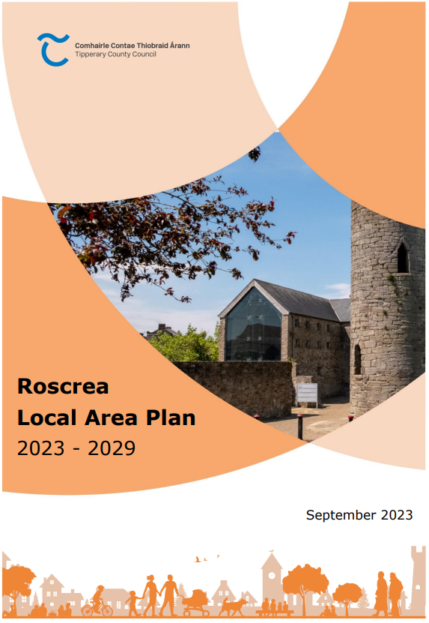
Planning Policies – Roscrea LAP
Planning and Development Policy
It is the policy of the Council to:
Policy 3.1 | Enable the collaborative redevelopment and reuse of vacant and underused sites and areas in the ‘Urban Core’ and ‘Compact Growth’ area, and in particular, to permit and support the redevelopment of Town Centre ‘Regeneration Sites’ and areas zoned for ‘Regeneration’ (see Section 3.2.1)
Policy 3.2 | Require new development proposals to be designed in accordance with the provisions of the Roscrea Town Centre Enhancement Plan 2013, the Roscrea Signage and Way-Finding Plan 2017 and the Town Centre First Plan
Policy 3.3 | Require new development proposals to accord with the county retail hierarchy and policy and to support and underpin the vibrancy and vitality of the town centre area and the PRA in line with the Retail Planning Guidelines for Planning Authorities (DEHLG, 2012)
Policy 3.4 | Require new development proposals in the Gantly Street area to accord with policies and objectives set out in the Gantly Street Masterplan, and any review thereof and Town Centre First Plan
Policy 3.5 | ermit new development which enhances the setting of Roscrea town centre, including its architectural and historical heritage and character. In the assessment of new development proposals to require and support quality urban design, compact growth, connectivity and active travel actions as opportunities arise.

Slide 9
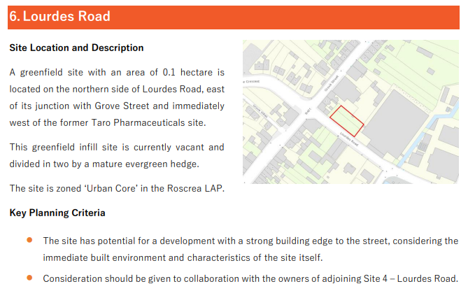
Planning Policies – Roscrea LAP
REGENERATION SITES

Slide 10
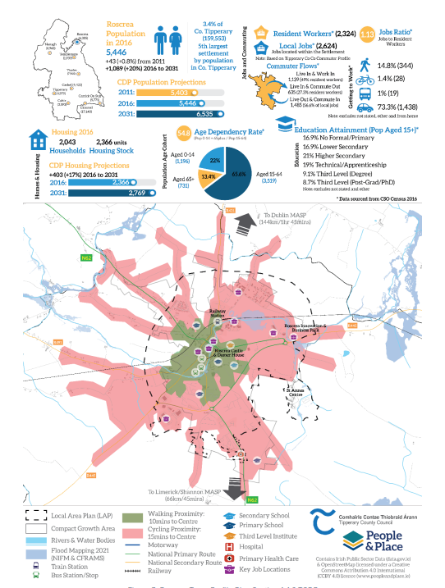
Town Profile Plans
Baseline for each town with key socio-economic data such as jobs ratio, transport modes, housing stock etc. In particular, the compact growth area and walking and cycling proximity as indicated, will support low-carbon development patterns including local transport planning and town centre regeneration
Notes:
Town profile plans set out a baseline for each town with key socio-economic data such as jobs ratio, transport modes, housing stock etc. In particular, the compact growth area and walking and cycling proximity as indicated, will support low-carbon development patterns including local transport planning and town centre regeneration in line with Chapters 7 and 12. This critical baseline data is important in delivering transformation over the lifetime of the Plan and acting as a measure for change.
The Council have prepared Draft LAPs in accordance with the Core Strategy, and Sections 4.3 and 4.4. New LAPs will, in collaboration with the local community and stakeholders, identify strategic objectives for each town consistent with the RSES and relevant Section 28 Guidelines, including land zoning, compact growth area, key sustainable mobility priorities, core retail area, settlement consolidation sites, strategic employment sites, architectural heritage, constraints such as flooding and any further relevant key future priorities.

Slide 11
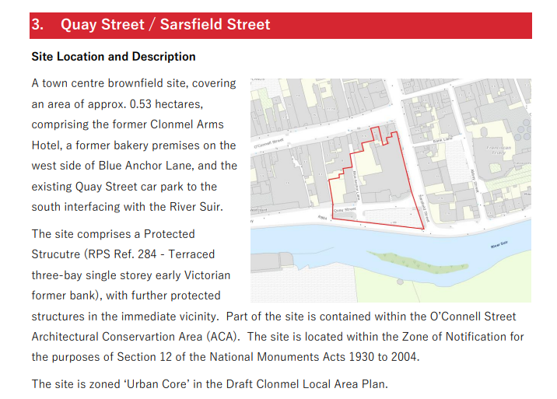
Regeneration Sites
14 sites identified
Vacant/underutalised/ brownfield
Development Brief
Regeneration Zoning

Slide 12
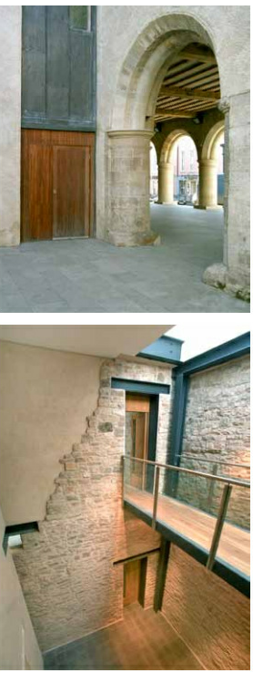
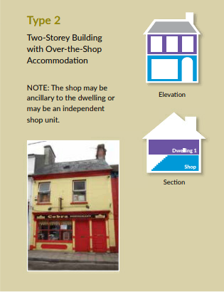
Adaptive Re-Use of Town Centre Properties
Design approaches
ACAs & Historic Character
Built Heritage Incentives
Diversity of Uses
Notes:
Identify opportunity sites within the Town Development Plan Areas and LAPs
Architectural Conservation Areas (ACA)s are places, areas, groups of structures, or a townscape, which are of special interest or contribute to the appreciation of protected structures. ACAs are designated in certain towns and villages for the purposes of maintaining the unique character of such townscapes and villages.
Heritage Led Regeneration - Home working imposed by lockdown has seen a desire by many to re-balance live-work arrangements and to improve quality of life and has led them to consider relocation to dwindling country towns to avoid long commutes. These societal shifts offer an opportunity for vacant town centre buildings and the plan supports the reuse of under-utilised buildings enabling appropriate and sustainable development and is supportive of consideration of the quality of the built environment as the setting for our lives, our work and recreation and the role of cultural heritage as the capital for societal well-being, innovation and for social cohesion. The Plan supports the integration of heritage – led strategies to deliver key infrastructural projects such as rural broadband and its sensitive installation in historic towns, the heritage-led regeneration of urban sites and the incorporation of trans-generational housing, accessible services such as health care centres adapting key town buildings and the wider consideration of cultural heritage
Bringing Back Homes – Manual for the ReUse of Existing Buildings.
Planning Authority can offer advice and guidance and make resources available to owners/occupiers.
Other Supports: Repair and Leasing Scheme
Buy and Renew Scheme
Better Energy Home Grants
Living City Initiative (LCI)
Long Term Leasing Scheme
HAP / RAS Schemes
Historic Buildings – Grant Schemes
Built Heritage Investment Scheme
Historic Structures Fund
Historic Towns Initiative
Heritage Council Grants

Slide 13
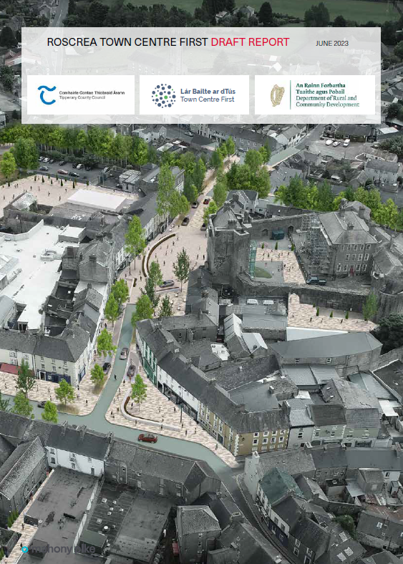
Town Centre First Policy
Town Regeneration Officer Town Centre First Plan
Department of Rural and Community Affair’s - “Our Rural Future”, Ireland’s Rural Development Policy 2021-2025
ACAs & Historic Character
Built Heritage Incentives
Diversity of Uses
Notes:
Tipperary County Council was awarded funding earlier this year of €100,000 to deliver a Town Centre First Plan for Roscrea Town. The funding has been awarded under the Department of Rural and Community Affair’s “Our Rural Future”, Ireland’s Rural Development Policy 2021-2025. The plan will help to develop Roscrea’s own unique vision and plan for its future development and once complete, will provide a basis for the town to seek support from multiple funding streams, including the Rural Regeneration Development Fund, (RRDF) and the Town & Village Renewal Schemes. A Town Regeneration Officer was appointed in November by Tipperary County Council and will initially work with Roscrea as the first pilot town in the County to have a TCF plan developed. The first steps will be to establish a Town Team for Roscrea for which expressions of interest were received as part of a public consultation process during the summer. A contract will be awarded shortly to appoint consultants to support the delivery of the Town Centre First Plan with the TRO and a timeframe for completion has been set for the summer of 2023.

Slide 14
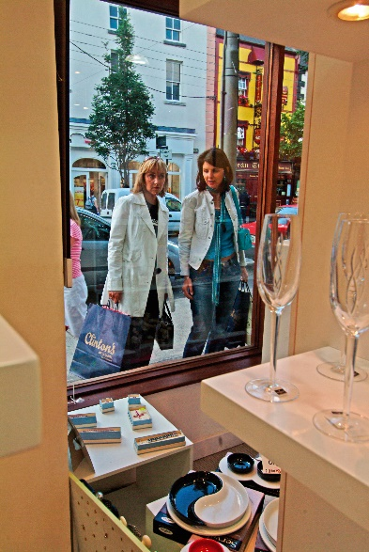
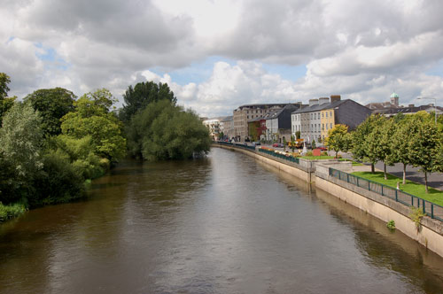
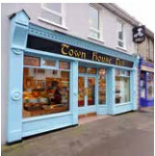
Retail Development
County Retail Hierarchy
Re-use and uptake of vacant properties
Rural Diversifications/tourism/artisan craft units
Notes:
Retailing plays an important function in ensuring buoyant and thriving centres, and the Council will pro-actively facilitate appropriate retail development proposals in town and village centres. In order to protect the function of town centres, retail developments at edge of town centres,
The retail hierarchy indicates where retail services of differing sizes scale and retail offer should be located, having regard to existing infrastructure and proximity to significant catchment populations. New retail development must be appropriate to the scale and function of the settlement in which it is located, in line with the retail hierarchy
The reuse and uptake of existing vacant retail units in town centre areas is a primary objective of the Plan. The Council will seek a proactive approach to addressing existing retail floor space vacancy and in cases where new development is proposed on edge of centre or out of centre sites, the Council will assess the need for the development, having consideration to the location of existing vacant retail floor space

Slide 15
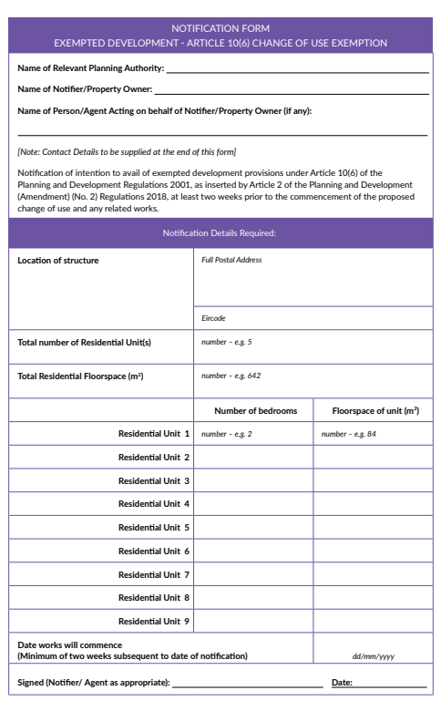
Planning Regulations
Article 10 (6)(a)
  Conversion of a commercial building under use classes 1 (shops), 2 (financial and professional services), 3 (offices) and 6 (guesthouses) to residential use is exempted development under certain conditions
  Max 9 units, Department guidelines, Protected Structure (S.57), Vacant 2 years, 2 week notice, DP/LAP Objectives

Slide 16
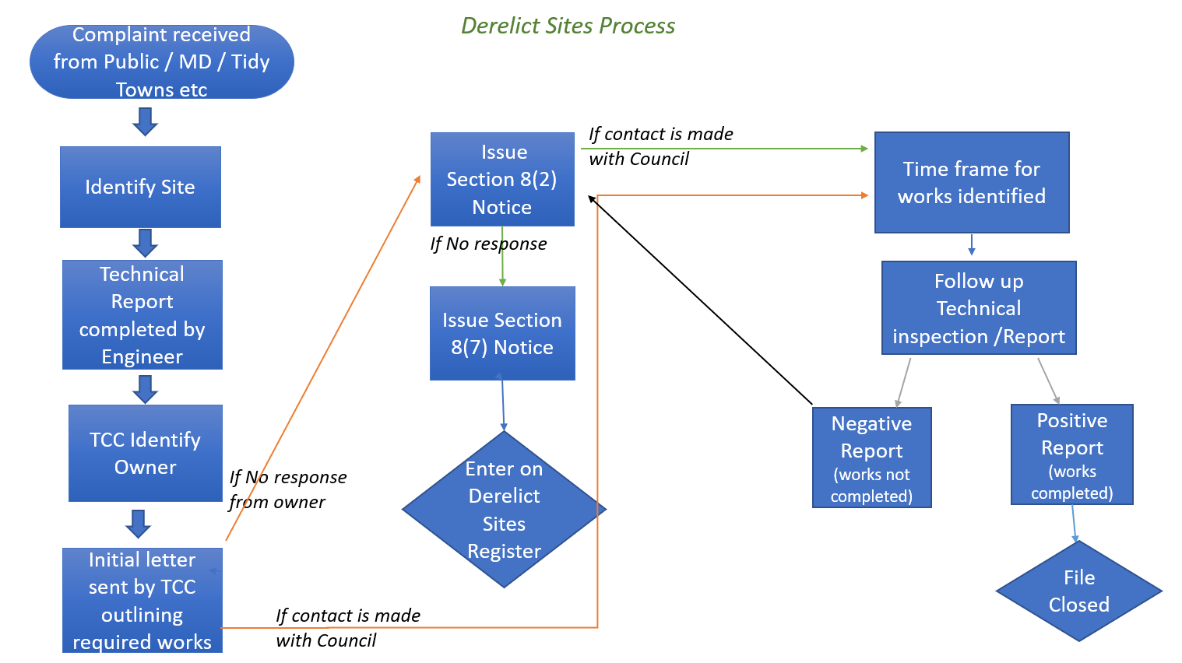
Derelict Sites
Notes:
our initial method of dealing with dereliction is through engaging with the property owners to give them an opportunity to remediate their properties, prior to going down the legal route. We find in many cases, that this method facilitates a quicker and more cost effect way of getting owners to carry out required works. As can be seen from the table below, through this intervention 12 properties were remediated in 2022 and avoided being placed on the Derelict Sites Register. TCC staff are currently engaging with 40 property owners in the Tipp Cahir Cashel District to ensure necessary works are undertaken.
If, following engagement, works remain outstanding and the property is still rendered derelict, then a Section 8(2) issues to the owner outlining the works required to render the site non-Derelict, giving the owner 4 weeks to respond to the notice in writing, or the site will be placed on the Derelict Sites Register and made available for public viewing. In 2022, 7 Section 8(2) notices issued to property owners in the Tipperary Cahir Cashel District.
Following this time period if no response has been received, the site is re-inspected and if none of the works have been completed then:
A Notice under Section 8(7) of the Derelict Sites Act is posted to the owner informing them that the site has been placed on the register, this can be posted along with:
A notice under Section 11 of the Derelict Sites Act, requiring the owner to carry out the works listed in the schedule in a specified time period or else face a financial penalty, a levy and/or a court summons.
In 2022, 2 Section 8(7) notices were issued in the Tipperary Cahir Cashel District.
The following statistics relate to the Tipperary, Cahir, Cashel Municipal District, do you think this is sufficient detail?
The current numbers of owner of derelict properties that we are currently engaging with (prior to issuing Section Notices) to prevent dereliction:
Table 1 – Engagement with Owners
(prior to Notices issuing)
No.
Number of property owners that TCC staff are currently engaging with in Tipp/Cashel/Cahir District: 40 (35.7% of total no. engaged with)
Total number of owners currently being engaged with - county wide: 112
Total number engaged with in Tipp Cahir Cashel in 2022 that have remediated their properties (avoiding entry on to the Derelict Sites Register) 12
Number of Section 8(2) Notices issued to properties in Tipperary Cahir Cashel in 2022 7
Number of Section 8(7) Notices issued to properties in Tipperary Cahir Cashel in 2022 and placed on the Derelict Sites Register 2
1 property was rendered non-derelict and removed from the Derelict Sites Register in Tipperary Cahir Cashel district in 2022

Slide 17

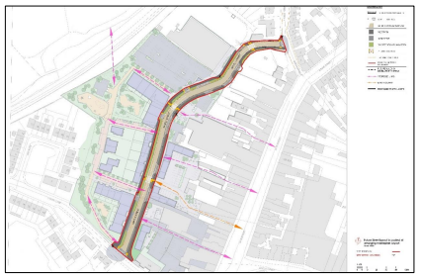
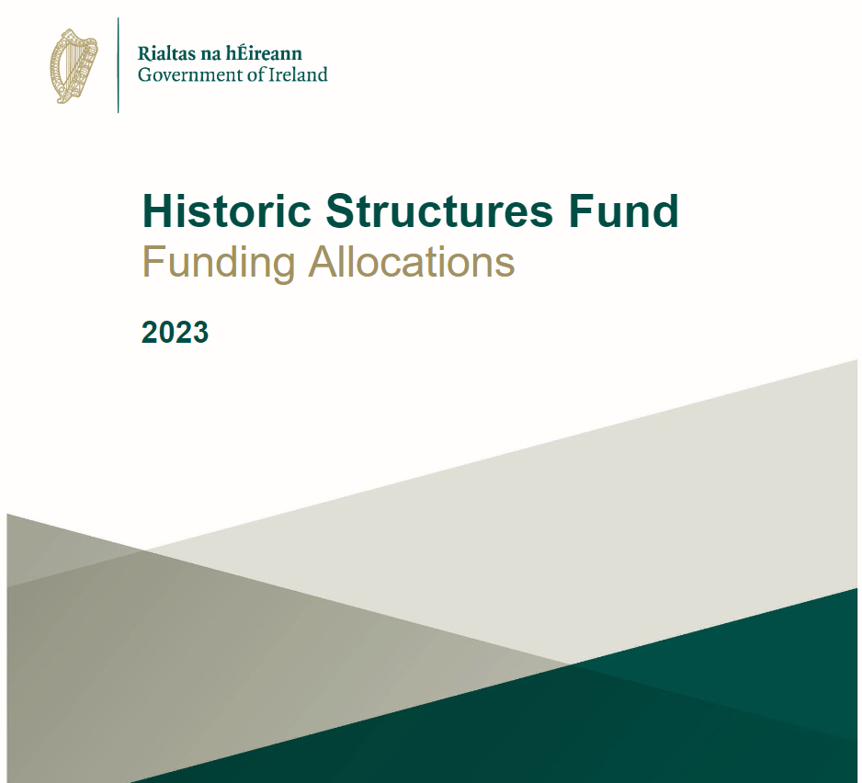
Regeneration projects and Grant Assistance
URDF & RRDF
Built Heritage Investment Scheme
Historic Structures Fund
Notes:
Council leads a significant regeneration programme focusing on towns, with multi-disciplinary teams to support renewal and regeneration, and to actively pursue economic regeneration and revitalising opportunities in line with Project Ireland 2040. Since 2018, significant funding has been received under the URDF and RRDF programmes and the Council. This collaborative placemaking framework for each town centre supports the overall vision of the development of each town in terms of a local and a strategic regeneration scale, building on their strengths and capacities, as set out in Chapter 4 Settlement Strategy.
PROJECT COSTS €90 million
FUNDED THROUGH:-
The Built Heritage Investment Scheme (BHIS) will assist custodians and owners of protected structures, and structures within Architectural Conservation Areas, in meeting their obligations to care for their historic properties. Through grants of up to €15,000, the BHIS will be used to undertake essential conservation works including joinery and roof repair, lime rendering, draught-proofing windows and repairing stained glass.
2023 - €126,000 allocated plus €21377 thatched – 24 offers made, 3 offers
2022 – 126.4K
2021 – 94.8
2020 – 79K
2019 – 79 505K
The Historic Structures Fund (HSF) will support custodians and owners of protected structures in maintaining and safeguarding their historic properties with grants, ranging from €15,000 to €200,000, assisting in essential conservation and repair works including casement and sash window repair, conservation of joinery and iron work, repointing stone work, roof repairs and thatching.
Historic Shopfronts Stream and Vernacular Structures Stream
2023 – 107,300
2022 – 42K
2021 – 150K
2020 – 90K
2019 – 67K €455K

Slide 18
Thank You

