Slide 1
Vacant Properties Seminar
Fire Safety
&
Building Control
Roscrea 20th November
Martin Moore C. Build E MCABE MIBCI (Reg. Building Surveyor)
Assistant Chief Fire Officer
Tipperary Fire & Rescue Service
Notes:
Just to introduce myself – I work in the fire service which also holds the function of building control. Not always the case nationally, sometimes building control is a separate section. In our case the Fire Officer will also be a Building Control Officer.

Slide 2
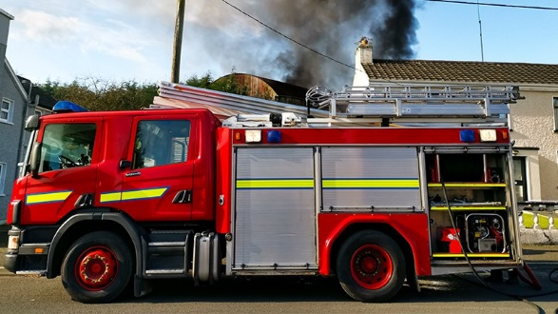
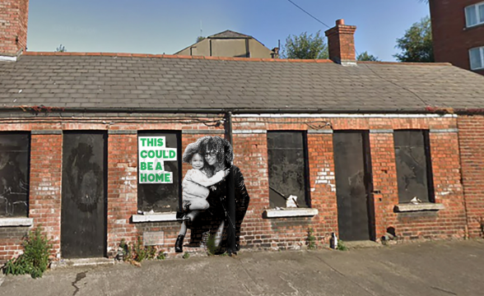
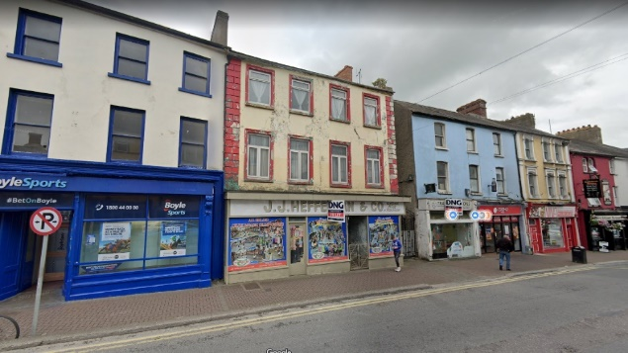
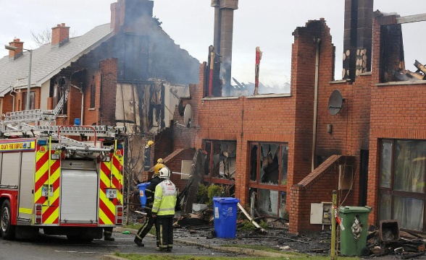
Overview
Main Legislation
Building Regulations and BC Regulations
Protected Structures
Guidance Documents Available
Typical Premises / Scenarios
Main Challenges Envisaged

Slide 3
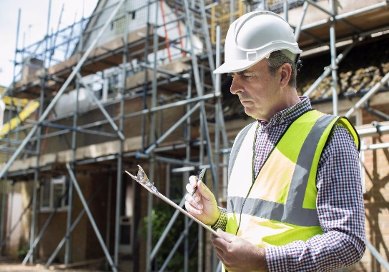
Get Competent Advice
1st Step – Engage a competent Registered Professional
Chartered Engineer - EI
Registered Architect - RIAI
Registered Building Surveyor - SCSI
2nd Step – Engage with Local Authority – Planning, Fire / Building Control, Housing, MD
Notes:
Cannot stress this enough – you must engage a competent registered professional for works. You cannot design layouts on a whim and you cannot go with a DIY approach for the situations we will be discussing. You will save money in the long run by spending it wisely on professional fees at an early stage.

Slide 4
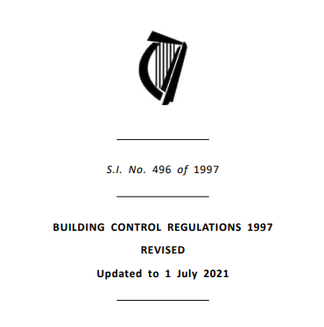
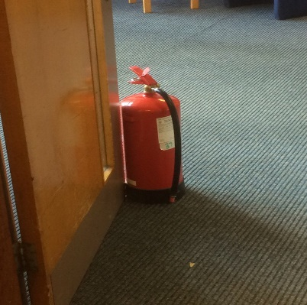
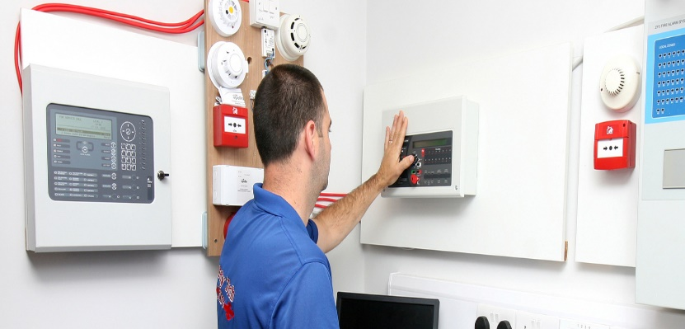
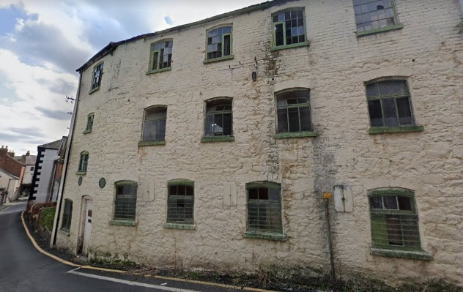
Legislation
Fire Services Acts 1981 & 2003
Section 18(2) – Duties on person in control..
Section 19 – Potentially Dangerous Building
Building Control Act 1990 - 2014
Building Regulations 1997 (as amended)
Building Control Regulations 1997 – 2021
Notes:
2 primary pieces of legislation that we work with.
Fire Services Acts apply at all times regardless of how old the building is and whether or not works are being carried out!
Where a building is considered a potentially dangerous building a Fire Safety Notice or Closure Notice may be placed on that building until remedial works are carried out to the satisfaction of the Fire Authority. (Legal Proceedings may be initiated). People we have prosecuted have gone to prison, or received a suspended sentence and a fine – take this seriously.
Section 18(2) outlines duties on persons in control of a premises – guard against the outbreak of fire, protect occupants in the event of fire etc
Section 19 – defines a potentially dangerous building – lack of fire alarm, adequate means of escape etc
A person guilty of an offence by reason of contravention of Section 18(2), shall be liable -
(a.) On summary conviction to a fine not exceeding €3,000 or to imprisonment for a term not exceeding 6 months, or to both, or
(b.) On conviction on indictment, to a fine not exceeding €130,000 or to imprisonment for a term not exceeding 2 years, or to both.
Building Regulations came into effect in 1992 – where works are being carried out they must comply with Building Regulations.
They provide provision such as:
Securing the health, safety and welfare of people in or about buildings
Making provision for disabled persons
Providing for the conservation of fuel and energy
Providing for the efficient use of resources
Encouragement of good building practice

Slide 5
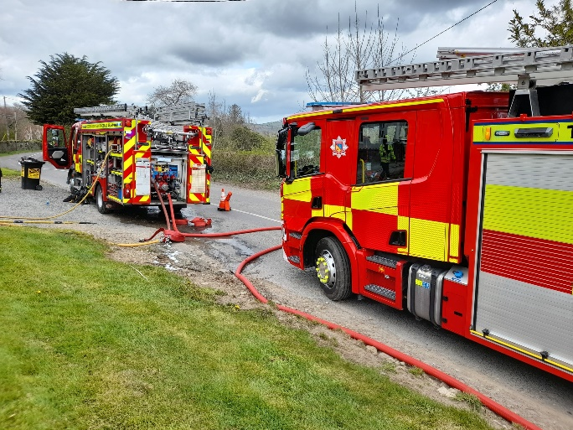
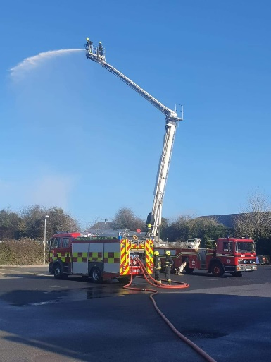
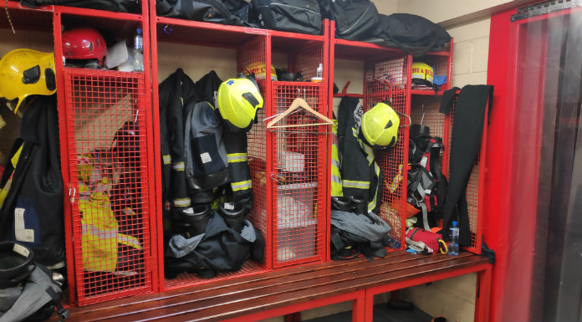
Fire Services Acts 1981 & 2003
Fire Services Acts 1981 & 2003
Section 18(2)
“It shall be the duty of every person having control over premises to which this section applies to—
(a) take all reasonable measures to guard against the outbreak of fire on such premises,
(b) provide reasonable fire safety measures for such premises and prepare and provide appropriate fire safety procedures for ensuring the safety of persons on such premises,
(c) ensure that the fire safety measures and procedures referred to in paragraph (b) are applied at all times, and
(d) ensure, as far as is reasonably practicable, the safety of persons on the premises in the event of an outbreak of fire whether such outbreak has occurred or not.”
Notes:
Fire Services Acts apply at all times regardless of how old the building is and whether or not works are being carried out!
Where a building is considered a potentially dangerous building a Fire Safety Notice or Closure Notice may be placed on that building until remedial works are carried out to the satisfaction of the Fire Authority. (Legal Proceedings may be initiated). People we have prosecuted have gone to prison, or received a suspended sentence and a fine – take this seriously.
Section 18(2) outlines duties on persons in control of a premises – guard against the outbreak of fire, protect occupants in the event of fire etc
Section 19 – defines a potentially dangerous building – lack of fire alarm, adequate means of escape etc
A person guilty of an offence by reason of contravention of Section 18(2), shall be liable -
(a.) On summary conviction to a fine not exceeding €3,000 or to imprisonment for a term not exceeding 6 months, or to both, or
(b.) On conviction on indictment, to a fine not exceeding €130,000 or to imprisonment for a term not exceeding 2 years, or to both.

Slide 6
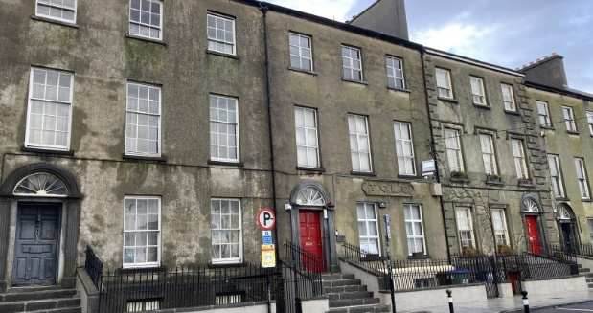
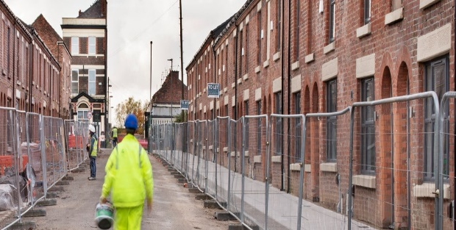
Building Regulations
Building Regulations – Health, Safety and Welfare (Parts A – M)
Part A – Structure
Part B – Fire Safety
Part C – Site Preparation and Resistance to Moisture
Part D – Materials and Workmanship
Part E – Sound
Part F – Ventilation
Part G – Hygiene
Part H – Drainage and Waste Water Disposal
Part J – Heat Producing Appliances
Part K – Stairways, Ladders, Ramps and Guards
Part L – Conservation of Fuel and Energy
Part M – Access and Use
Notes:
Building Regulations are there to ensure the health, safety and welfare of persons in and around buildings and the energy efficiency of buildings
The are non-prescriptive – It is the Building Control Authorities job to determine compliance. There are guidance documents to prove prima facie compliance however there are other ways to prove compliance – hence the importance of getting competent advice early.
Building Regulations came into effect in 1992 – where works are being carried out they must comply with Building Regulations.
They provide provision such as:
Securing the health, safety and welfare of people in or about buildings
Making provision for disabled persons
Providing for the conservation of fuel and energy
Providing for the efficient use of resources
Encouragement of good building practice

Slide 7
Building Regulations
Material Alterations and Extensions – All Parts of Building Regulations apply
Material Change of Use – only some of the Parts of the Building Regulations apply;
Part A1 – Structure (Loading)
Part B - Fire Safety
Part A2 - Structure (Ground Movement)
Part C4 - Site Preparation and Resistance to Moisture (Resistance to Weather and Ground Moisture)
Part E - Sound,
Part F - Ventilation,
Part G - Hygiene,
Part H - Drainage and Waste Water Disposal,
Part J - Heat Producing Appliances,
Part L - Conservation of Fuel and Energy,
Part M* - Access and Use.
* Part M only applies to elements that are altered or provided that are covered by Part M (e.g. if a passenger lift is decided to be installed the lift must conform to Part M).

Slide 8
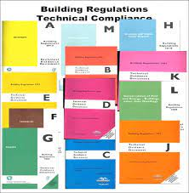
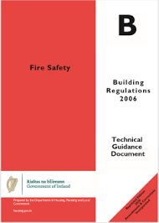
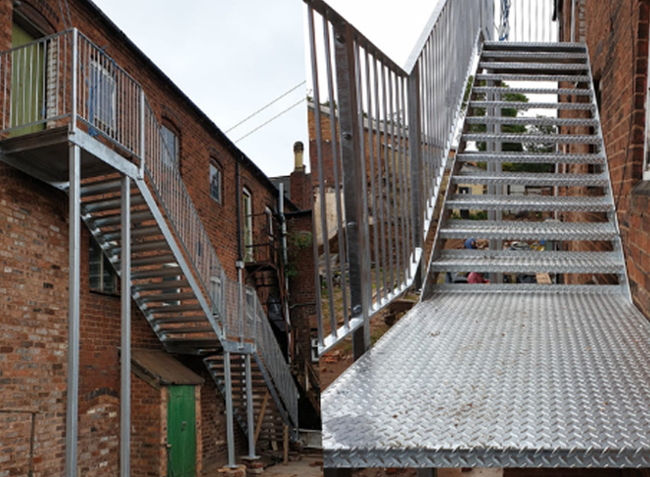
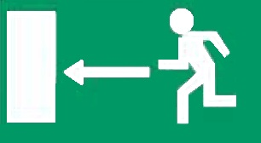
Building Regulations
Regulation Vs. Guidance
Regulation B1 – Means of escape in case of fire
A Building shall be so designed and constructed that there are adequate means of escape in case of fire…
Guidance – maximum travel distance to an exit should be………
Notes:
Building Regulations are there to ensure the health, safety and welfare of persons in and around buildings
The are non-prescriptive – It is the Building Control Authorities job to determine compliance. There are guidance documents to prove prima facie compliance however there are other ways to prove compliance – hence the importance of getting competent advice early.
If you follow TGD B to the full extent you will be fully compliant with Part B of the Building Regulations – but there are other ways of proving compliance.

Slide 9
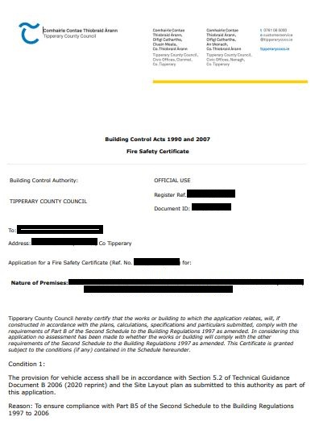
Building Control Regulations
BC Regulations provide a conduit for proving compliance
Fire Safety Certificates
Disability Access Certificates
Commencement Notices
Notes:
Building control regulations – they are there to provide a means of proving compliance with the building regulations. Items covered under the building control regulations include fire safety certificates, disability access certificates and commencement notices.
All of above can be lodged on the Building Control Management System which your consultant will be fully aware of.

Slide 10
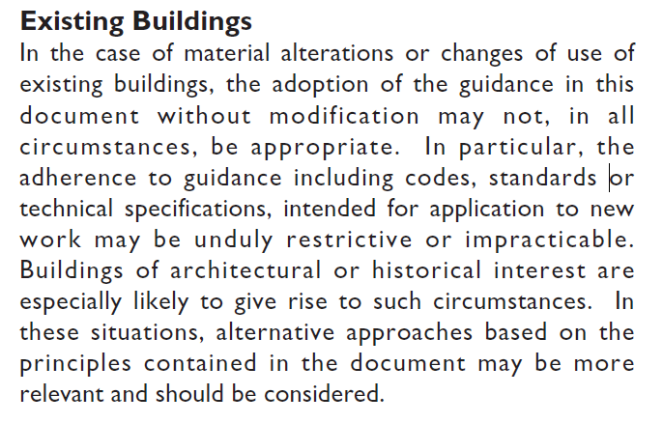
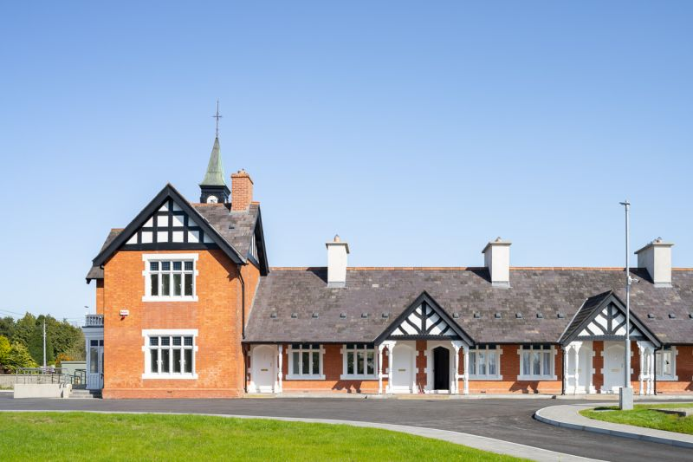
Protected Structures
No Exemption from Building Regulations….
Except from Part L (Conservation of Energy)
Full exemption if it is subject to the National Monuments Acts
Case can be made for….
What's practicable?
Compensatory measures / features
12th / 13th Century Rock of Cashel
National Monument
Stanwix Village – Dublin Rd, Thurles
Protected Structure
Notes:
13th Century Castle cannot be expected to comply with the Building Regulations in any form – as such it is exempt (Schedule 3 of the Building Regulations)
Standwix House – has to comply with Building Regulations and recently granted Fire Safety Certificate for commercial ground floor and flats above
Up to the applicants agent to prove what's practicable and it will ultimately rest with the Building Control Authorities decision
Compensatory measures may be an enhanced fire detection and alarm system, increased fire resistance, a pressurised escape stairs shaft
All can be discussed with your consultant and the Fire / Building Control Officer.

Slide 11
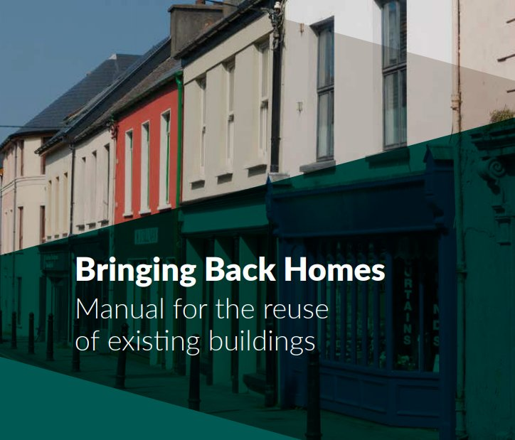
Guidance Documents
Bringing Back Homes
Fire Safety Certificates
Disability Access Certificates (no longer required for flats)
Application of the Building Regulations
Commencement Notices
Fire Safety in Flats
Technical guidance on fire safety in existing flats - management of fire safety, means of escape, structural fire precautions, building services etc
Technical Guidance Documents A-M
Technical guidance on complying with Building Regulations
Notes:
Plenty of free documents available offering technical advice – these can be discussed with your registered professional
Bringing Back Homes document – very detailed and accessible document that will outline planning, fire and building control requirements for a number of scenarios. Worth reviewing
Technical Guidance Documents A-M – these technical documents are provided for professionals to assist the design in complying with Parts A-m of the Building Regulations
Fire Safety in Flats guidance document – published by the department of environment back in 1994. It is a technical document that provide advice on fire safety management aswell as the layout of flats. Came about to provide assistance on meeting your duties under the fire services acts for existing flats. If you have a building that was used for flats prior to 1992 then you can comply with this document otherwise they building should be in accordance with part b of the building regulations.

Slide 12
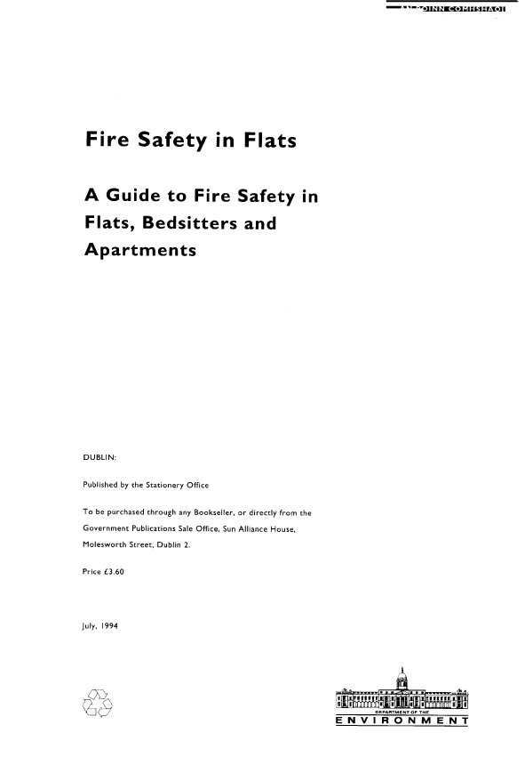
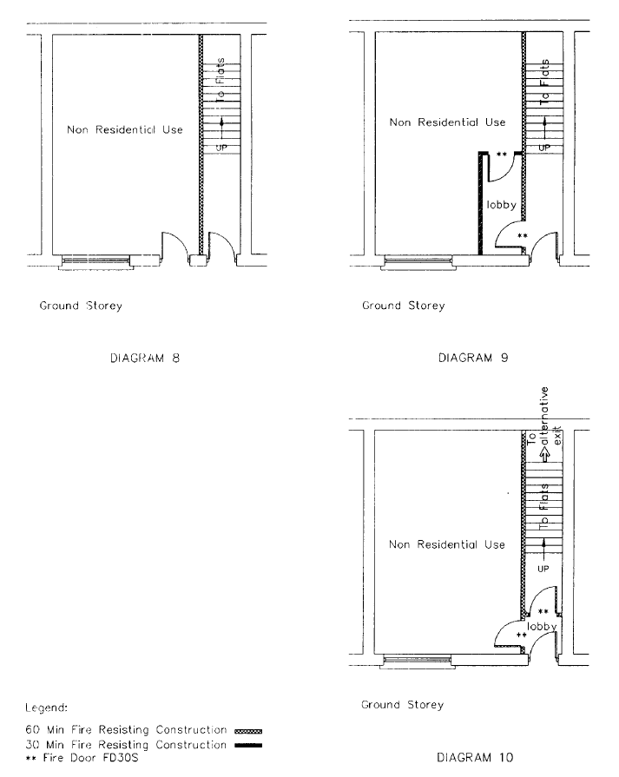
Guidance Documents

Slide 13
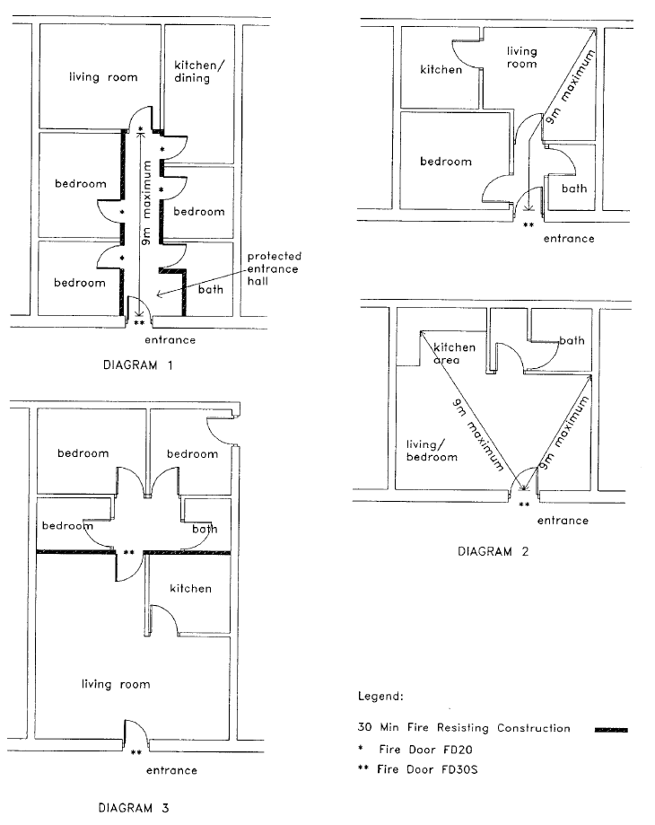
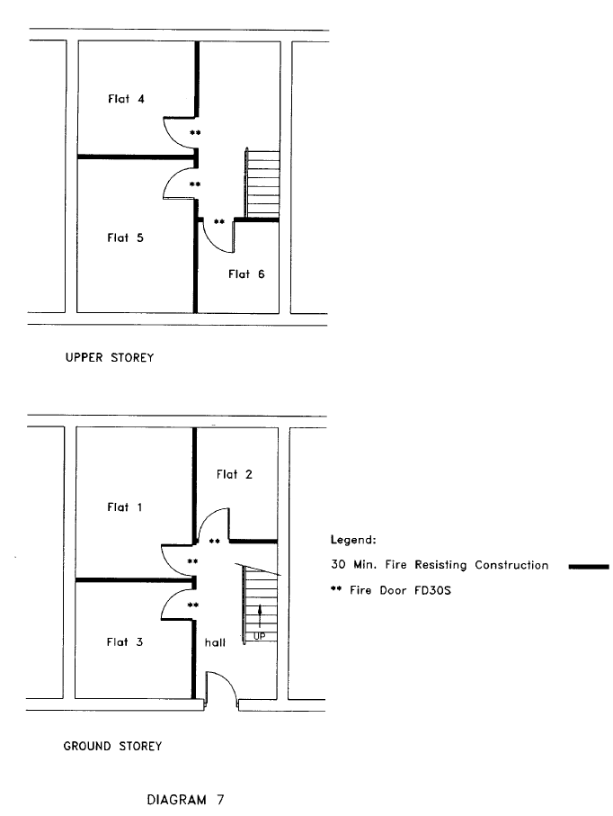
Guidance Documents

Slide 14
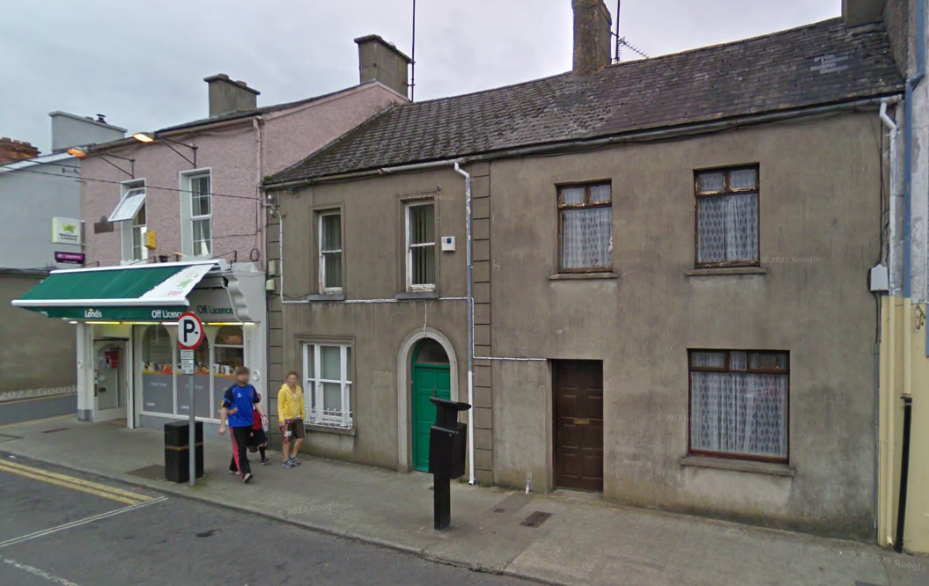
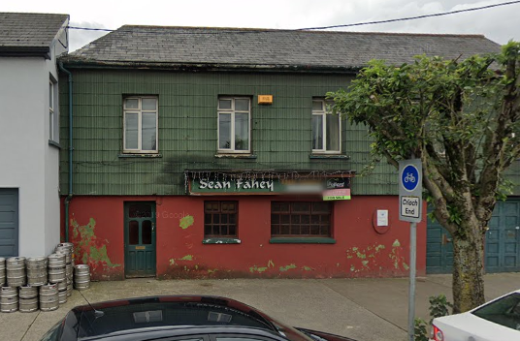
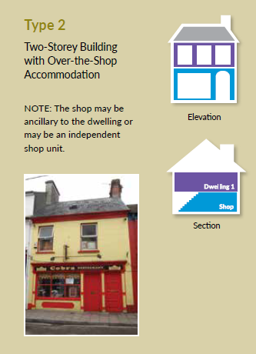
Typical Premises / Scenario’s
2 Storey Building – Potential Use?
Commercial ground floor with residential accommodation above
2 storey apartment / flat building
2 storey dwelling house

Slide 15
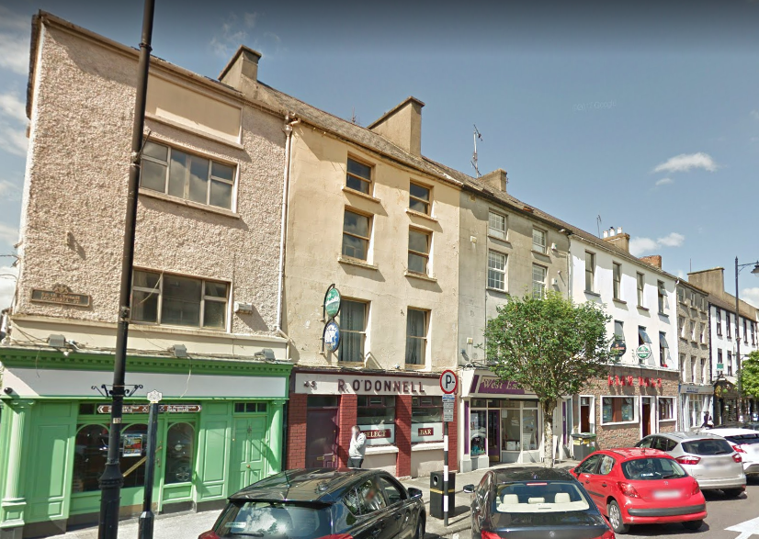
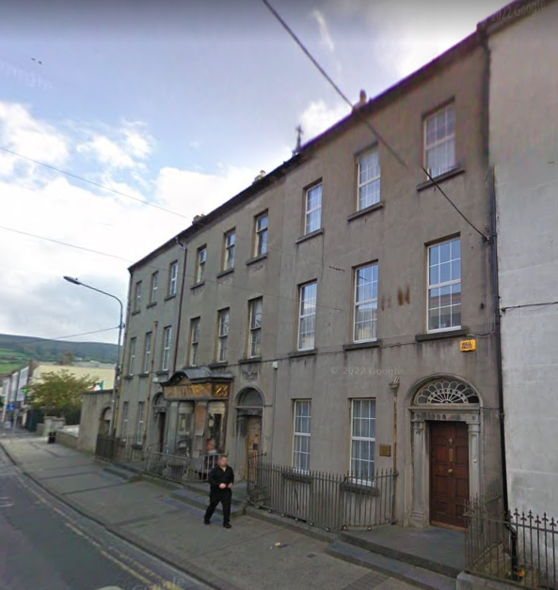
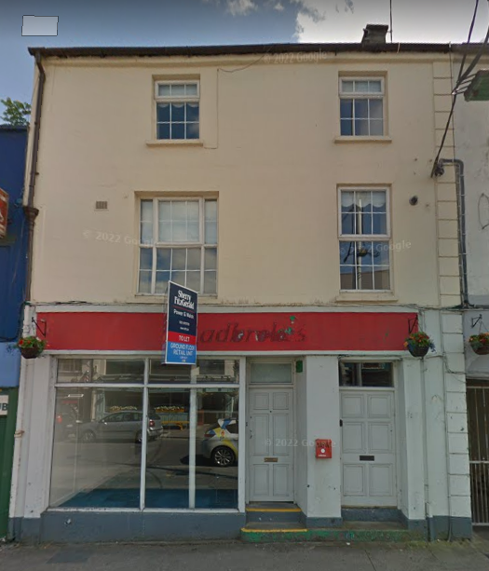
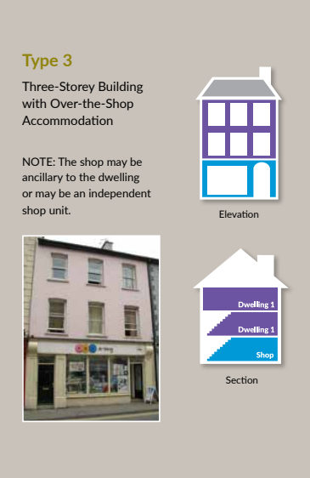
Typical Premises / Scenario’s
3 Storey Building – Potential Use?
Commercial ground floor with residential accommodation above
3 storey apartment / flat building
3 storey dwelling house

Slide 16
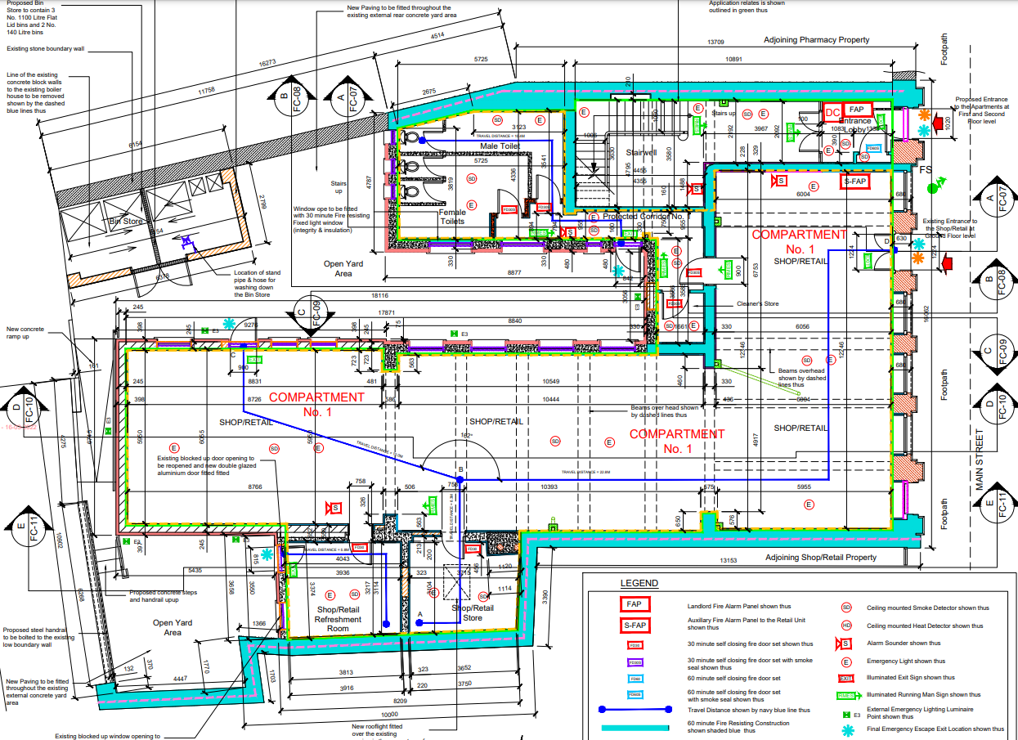
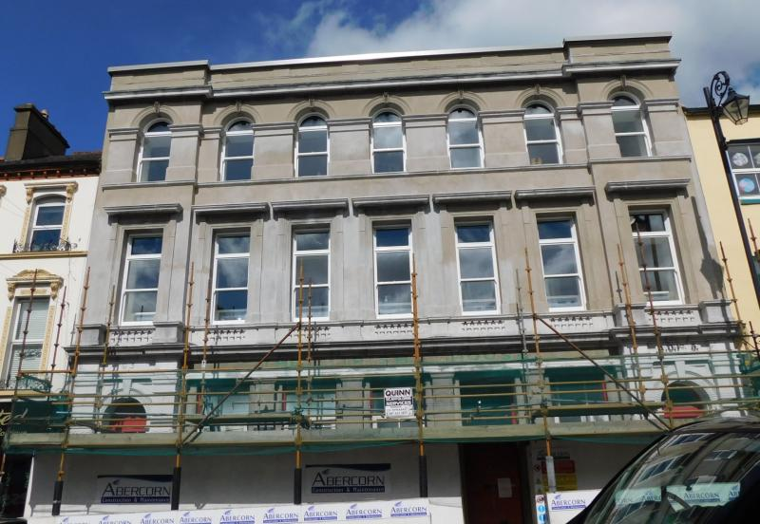
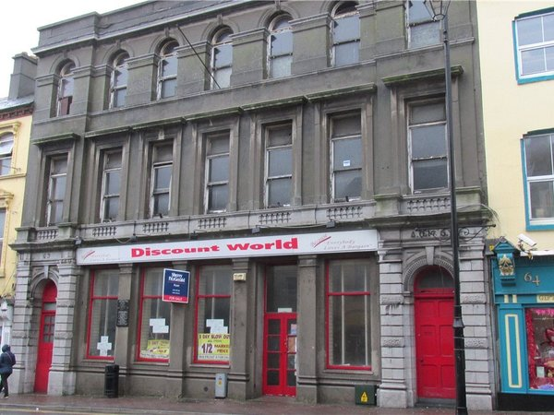
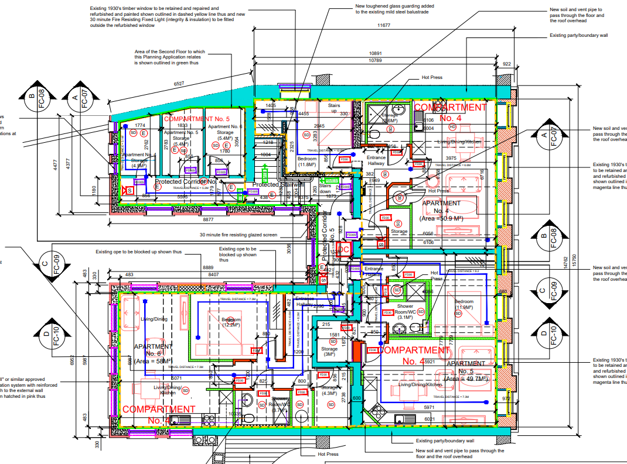
Refurb Project
The Irish House – Tipperary Town
Notes:
Built circa 1890

Slide 17
Challenges Envisaged
Existing Buildings
Generally constructed prior to Building Regulations
Older construction / materials (no fire doors / protected escape routes / compartmentation)
Location of Stairways
Dedicated escape stairs for residential areas – separate to commercial
Existing stairs may be terminating into a kitchen / living room
Poor Layouts
Long pathways / escape routes / no access back to street
Deep building plans
Separation of different occupancies
Apartment above shop
But…..solutions can be found!

Slide 18
Summary
Appoint a competent Technical Advisor – Can’t be a “DIY” job
Fire Services Acts 1981 & 2003 and Building Control Act 1990 to 2014
FSC’s, DAC’s, CN’s
Guidance Available
Existing Buildings – challenging but significant reward

Slide 19
Questions?
Martin Moore C. Build E MCABE (Reg. Building Surveyor)
Assistant Chief Fire Officer
Tipperary Fire & Rescue Service

